Slide 1
Lecture 22 - Streams

Slide 2

Streams

Slide 3
Lazy Evaluation in Scheme

Slide 4
Lazy evaluation
In Python, iterators and generators allowed for lazy evaluation
def ints(first):
while True:
yield first
first += 1
>>> s = ints(1)
>>> next(s)
1
>>> next(s)
2
Can represent large or infinite sequences
Scheme doesn't have iterators. How about a list?
(define (ints first)
(cons first (ints (+ first 1)))
Second argument to cons is always evaluated
scm> (ints 1)
maximum recursion depth exceeded

Slide 5
Streams
Instead of iterators,
Scheme uses streams
(define (ints first)
(cons first
(ints (+ first 1)))
(define (ints first)
(cons-stream first
(ints (+ first 1)))
scm> (ints 1)
maximum recursion depth exceeded
scm> (ints 1)
(1 . #[promise (not forced)])
Lazy evaluation, just like iterators in Python

Slide 6
Streams
scm> (define s (cons-stream 1 (cons-stream 2 nil)))
s
scm> s
(1 . #[promise (not forced)])
scm> (car s)
1
Stream: (linked) list whose rest is lazily evaluated
A promise to compute
I don't need the rest of this list right now. Can you compute it for me later?
Sure, I promise to compute it right after I finish watching Stranger Things.
scm>

Slide 7
Streams
scm> (define s (cons-stream 1 (cons-stream 2 nil)))
s
scm> s
(1 . #[promise (not forced)])
scm> (cdr s)
#[promise (not forced)]
cdr returns the rest of a list
For normal lists, the rest is another list
The rest of a stream is a promise to compute the list
I want the cdr of the list now.
Just one more episode. I'm almost done with season 3.
scm>

Slide 8
Streams
scm> (define s (cons-stream 1 (cons-stream 2 nil)))
s
scm> s
(1 . #[promise (not forced)])
scm> (cdr-stream s)
(2 . #[promise (not forced)])
scm> (cdr-stream (cdr-stream s))
()
cdr-stream forces Scheme to compute the rest
cdr-stream !
Fine! Here's your stupid list.
scm>

Slide 9
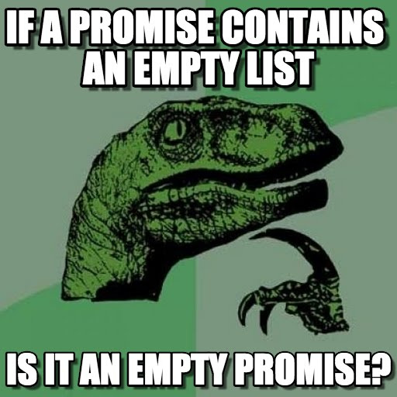
Streams
Remember, a stream is just a regular Scheme pair whose second element is a promise
scm> (define s (cons-stream 1 (cons-stream 2 nil)))
s
scm> (cdr s)
#[promise (not forced)]
scm> (cdr-stream s)
(2 . #[promise (not forced)])
scm> (cdr-stream (cdr-stream s))
()
Promise:
(cons-stream 2 nil)
Promise:
(cons-stream 2 nil)
Promise:
nil
Promise:
nil
1
2

Slide 10
Streams
Streams
Promises
Examples
Streams Exam Problems

Slide 11
Promises: delay
Promise: an object that delays evaluation of an expression
The delay special form creates promises
scm> (print 5)
5
x
scm> (delay (print 5))
#[promise (not forced)]
(print 5) is immediately evaluated
(print 5) is not evaluated yet
Promise:
(print 5)

Slide 12
Promises: force
The delay special form creates promises
The force procedure evaluates the expression inside the promise
scm> (define x (delay (print 5)))
x
scm> x
#[promise (not forced)]
(print 5) is not evaluated yet
scm> (force x)
5
Evaluates (print 5)
scm> x
#[promise (forced)]
Promise:
(print 5)
Promise:
(print 5)
5

Slide 13
Promises
cons-stream and cdr-stream are syntactic sugar. Achieve the same effect with delay and force
scm> (define s (cons-stream 1 nil)))
s
scm> s
(1 . #[promise (not forced)])
scm> (cdr-stream s)
()
scm> (define s (cons 1 (delay nil))))
s
scm> s
(1 . #[promise (not forced)])
scm> (force (cdr s))
()
Promise:
nil
Promise:
nil
1

Slide 14
Recursively Defined Streams - Constant Stream
Let’s start with the constant stream. A constant stream is an infinitely long stream with a number repeated.
(define (constant-stream i)
(cons-stream i (constant-stream i)))
scm> (define ones (constant-stream 1))
scm> (car ones)
1
scm> (car (cdr-stream ones))
1
Why does this work?
We know cons-stream takes in a value and a stream, and we know constant-s returns a constant stream. Thus we will have an infinitely long constant stream. Why doesn’t this error?

Slide 15
Check Your Understanding: Natural Number Stream
Let’s define the naturals stream which is an infinitely long stream with the natural numbers starting at start.
(define (nats start)
______________________________)
scm> (define s (nats 0))
scm> (car s)
0
scm> (car (cdr-stream s))
1
scm> (car (cdr-stream (cdr-stream s)))
2

Slide 16
Natural Number Stream
(define (nats start)
(cons-stream start (nats (+ start 1)))
Why does this work?
We know cons-stream takes in a value and a stream, and we know nats returns a stream.
We know a function call to (nats (+ start 1)) will return us a naturals streams starting at start + 1, so what value is left? Start, which we place in the stream constructor before the recursive call.

Slide 17
Add-Stream and Ints-Stream
Let’s write a function that will add two infinite streams together and return a new stream.
(define (add-stream s1 s2)
(cons-stream (+ (car s1) (car s2))
(add-stream (cdr-stream s1) (cdr-stream s2)))
)
Let’s see it in action! Let’s first define the ones stream again.
(define ones (cons-stream 1 ones))
This is the same as (constant-stream 1).
Let’s use the ones stream and our new add-stream function to define the ints stream. This is the same as (nats 1). How do we do this?
(define ints (cons-stream 1 (add-stream ? ?))

Slide 18
Ints-Stream Solution
(define ones (cons-stream 1 ones))
(define ints (cons-stream 1 (add-stream ones ints))
ones: 1 1 1 1 1 ...
|
|
+
|
|
|
|
+
|
|
|
|
+
|
|
|
|
+
|
|
ints: 1
2
3
4
5 ...
We can use infinite streams to build other infinite streams. This is the power of lazy evaluation, our current stream stays one step ahead of itself!

Slide 19
Examples: map-stream
Implement (map-stream fn s):
fn is a one-argument function
s is a stream
Returns a new stream with fn applied to elements of s
(define (map-stream fn s)
'YOUR-CODE-HERE
)

Slide 20
Examples: map-stream
How would you implement map-list?
(define (map-list fn s)
(if (null? s)
nil
(cons (fn (car s))
(map-list fn (cdr s)))))
How about map-stream?
(define (map-stream fn s)
(if (null? s)
nil
(cons-stream (fn (car s))
(map-stream fn (cdr-stream s)))))
What happens if you change this to cons?

Slide 21
Examples: stream-to-list
Implement (stream-to-list s num-elements):
s is a stream
num-elements is a non-negative integer
Returns a Scheme list containing the first num-elements elements of s
scm> (stream-to-list (ints 1) 10)
(1 2 3 4 5 6 7 8 9 10)
(define (stream-to-list s num-elements)
'YOUR-CODE-HERE
)

Slide 22
Examples: stream-to-list
Step 1: Base case(s).
Simplest input for s:
If s is nil: no elements, so return nil
Simplest input for num-elements
If num-elements is 0: return nil (a list containing 0 elements)
(define (stream-to-list s num-elements)
(if (or (null? s) (= num-elements 0))
nil
)

Slide 23
Examples: stream-to-list
Step 2: Recursive call
How to reduce inputs?
(stream-cdr s) computes the rest of the stream
(- num-elements 1) reduces the number of desired elements
What does (stream-to-list (stream-cdr s) (- num-elements 1)) do?
Gets the first (- num-elements 1) elements of the rest of s
(define (stream-to-list s num-elements)
(if (or (null? s) (= num-elements 0))
nil
)

Slide 24
Examples: stream-to-list
Step 3: Use the recursive call
Add (car s) to the front of the list returned by the recursive call
How do you create a list in Scheme? cons
(define (stream-to-list s num-elements)
(if (or (null? s) (= num-elements 0))
nil
(cons (car s)
(stream-to-list (cdr-stream s)
(- num-elements 1))))
)

Slide 25
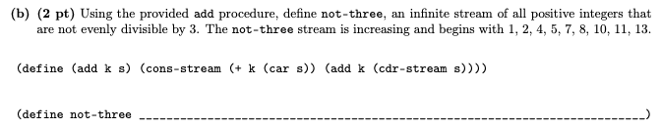
Exam-Level: not-three (Fa18 Q6b)
(define not-three (cons-stream 1 (cons-stream 2 (add 3 not-three))))

Slide 26
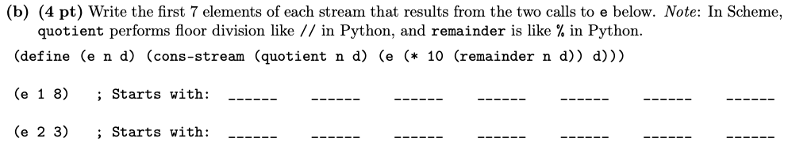
Check Your Understanding: Scheme Forever (Sp18 Q6b)
(e 1 8) 0 1 2 5 0 0 0
n: 1 -> 10 -> 20 -> 40 -> 0
d: 8
(e 2 3)
n:
d:

Slide 27
Streams
Streams are how we implement lazy evaluation in Scheme.
We use cons-stream to create streams and cdr-stream to evaluate the promise.

